Slide 1

Developing an interactive map of snowpack properties in WA state
MoSnoPro-US 🏔️❄️
Danny Hogan, Bow Sruangsung, Xinya Tang, Jane Dai
image: SimpLine

Slide 2
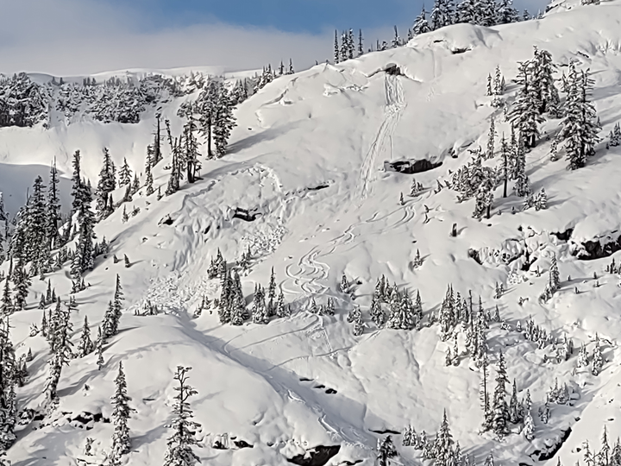
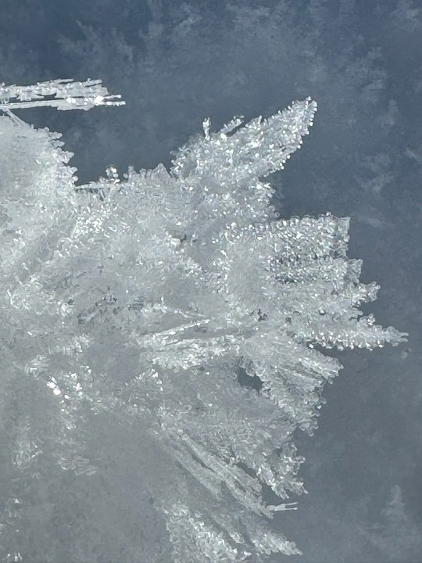
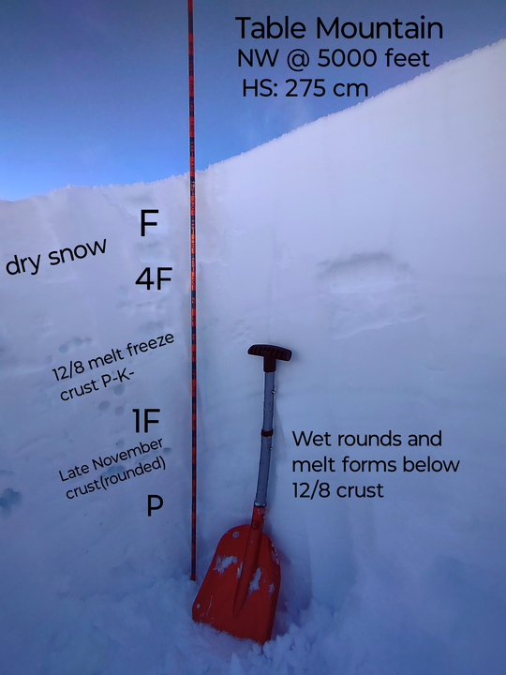
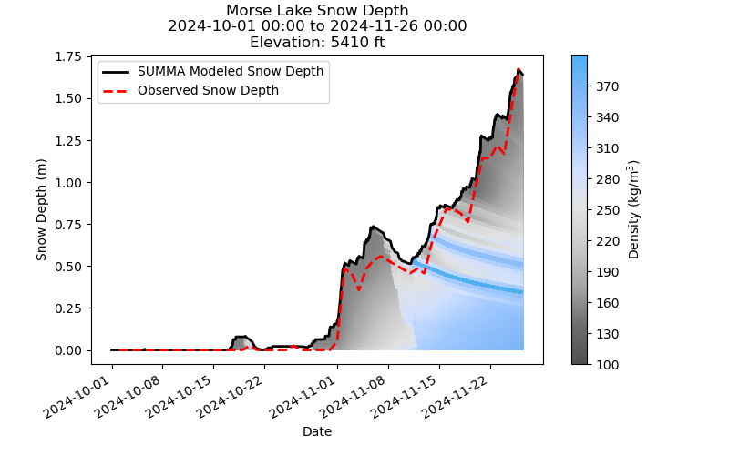
Notes:
OVERVIEW SLIDE

Slide 3
Human-centered design
Project Goal
Provide near real-time snowpack data visualization
improve decision-making for avalanche forecasts, safety, and recreational planning
Key Features
Interactive Map
Data Filtering
User-friendly visualization
Human-Centered Design
~ 22 Users Profiles (data analysts, traffic engineers, forecasters, and recreationists)
Interaction flow
Data Analysts: Query datasets → Filter data → Generate custom plots.
Researchers: Analyze trends → Identify patterns → Use insights in publications.
Decision Makers: Input thresholds → Receive alerts → View summarized recommendations via visualizations.
Feedback-driven
Accessibility
Notes:
[BOW]

Slide 4
Human-centered design
Component | Users | Key Features Benefiting Users
Data Manager | Data Analysts, Researchers | Querying data subsets, preprocessing for research/analysis.
Visualization Manager | All users | Interactive and static plots, trend graphs, and map visuals.
Decision Support Module | Decision Makers | Alerts, thresholds, and recommendations for safety responses.
Notes:
[BOW]

Slide 5

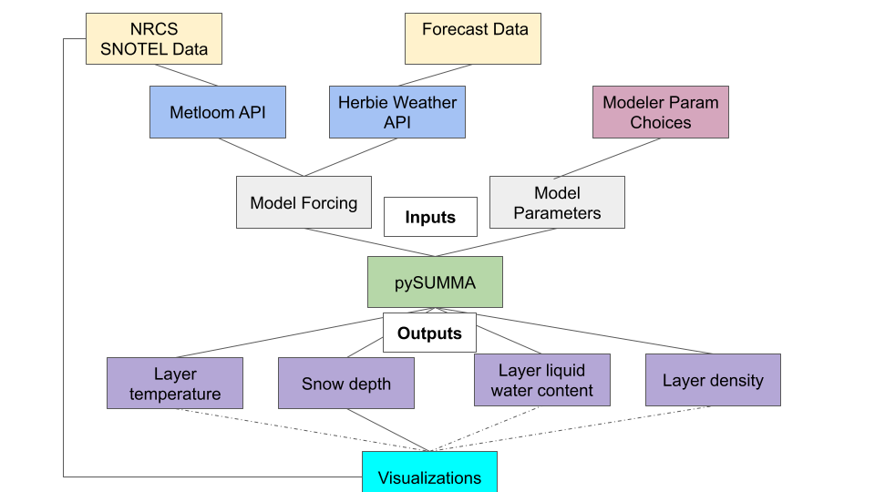
Selecting software and data
After the tech review, Streamlit was chosen:
Provides open-source app framework, ease of deploy
Quick to learn, minimum front-end experience required
Capability to create interactive dashboards for visualization.
Notes:
[XINYA] Next part is the software and data selection. We chose Streamlit for its ease of deploy and strong capability to, so that we can better achieve the project goal, which is to build Interactive Map with near real-time data vis. The main dataset will be from NRCS (National Resource Conservation Service) SNOTEL weather stations throughout Washington, which provide Real-time weather observations data such as snow depth, temperature. If we go the forecasting route Short-term forecasts data. Metloom and Herbie are Data Access Tools. All the data inputs will go to the model named pySUMMA: It’s A flexible hydrologic model for simulating snowpack characteristics, outputs include xxxx. Our visualizations and interactive functions will be built on the model outputs.

Slide 6
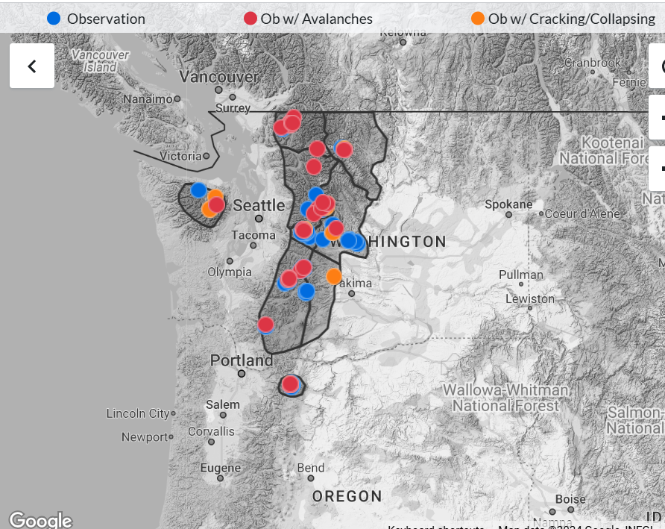
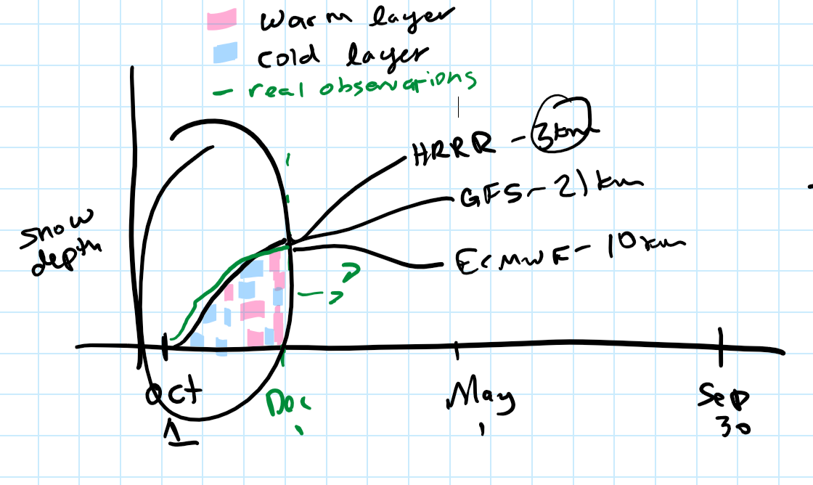
expectation
Notes:
VISION - IDEAL #1 (10s)

Slide 7

reality
Notes:
VISION - IDEAL #1 (10s)

Slide 8
Challenges
Team had wide range of familiarity with software tools
Spent a lot of class time thinking about software features and components
Generating the figure from scratch takes a lot of time, may be a source of frustration for other users
Kept detailed notes; used Slack to communicate more flexibly in addition to GitHub
Good shared understanding, but left limited time towards the end for implementation. We made peace with version 0.
Opportunity to practice software development, but not realistic for long-term usability

Slide 9

Next steps
Optimize data storage solution (we used Dropbox) that is better suited for water and snow data (Hydroshare), or even just Google Drive
Scaling to more sites (all SNOTEL sites in WA state) would create data limitations
Additional features to consider adding:
Adding color-coded 🚥 attributes in hover pop-ups
Explicit buttons for exporting data/images
Forecast for limited periods (few days, one week)
Notes:
[JANE onwards]

